Slide 1
Video Game Sales Database
Melissa Olhausen, Nathaniel Morris, Solomon Paprocki

Slide 2


Presentation Outline
Description
Functionality
Implementation
Demonstration
Evaluation
Conclusion

Slide 3
Description
Application Domain:
This is a database has information about the sales figures of over 16,000 video games
Importance:
This domain is needed to help people learn more about video game sales records

Slide 4
(Functionality) The user can…
View
view top games based on genre and different metrics
Edit
edit game info
Add
add a review to a game
Search
search for a game

Slide 5

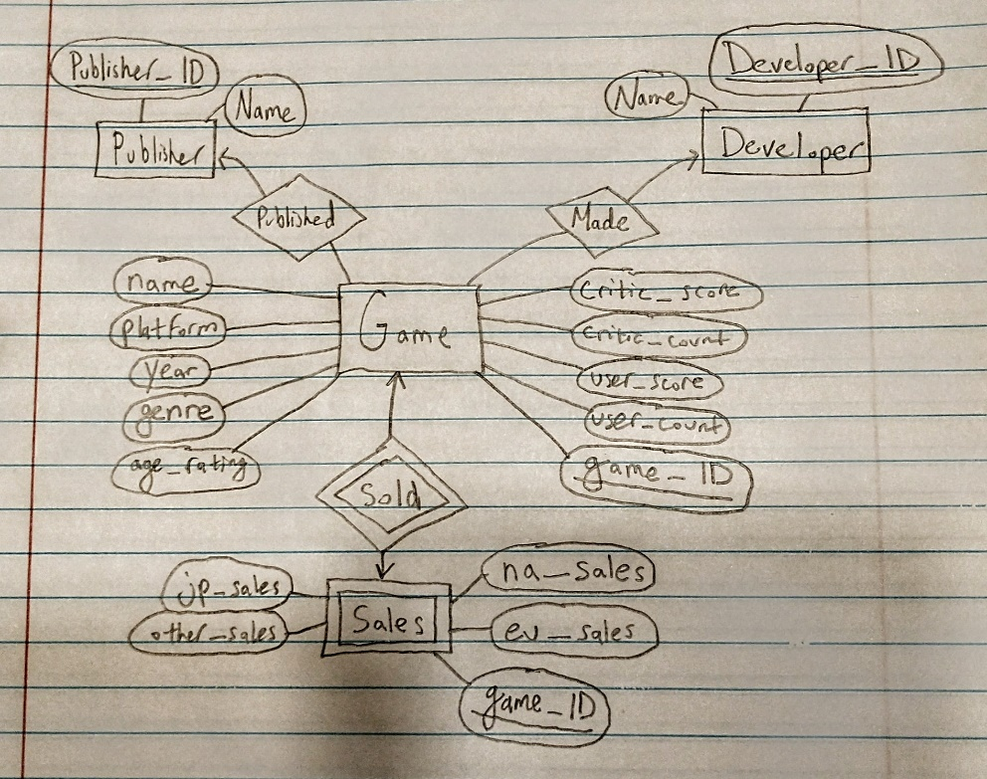
Implementation
There are 4 entities: game, publisher, developer, and sales
Game is connected many-to-one with publisher, where one publisher can have many games. Game has this same relationship with developer.
Sales is a weak entity set, which depends on the ID of game.
There are 4 tables, the game table has over 16,000 records.

Slide 6
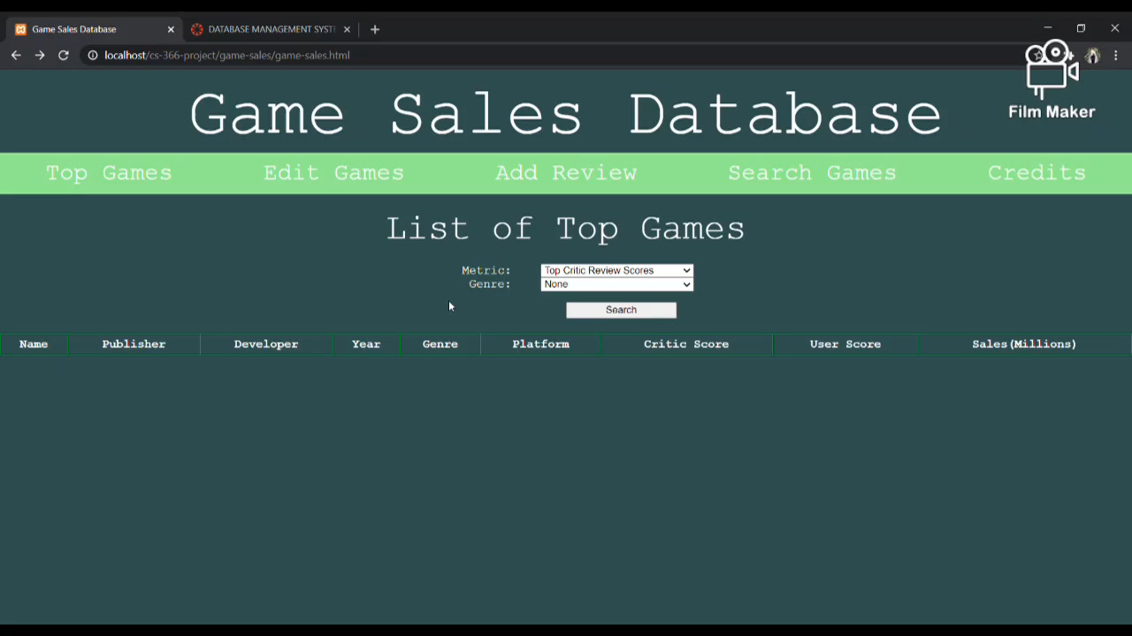
Demonstration

Slide 7

Evaluation
We strived to maintain database integrity
We focused on making our application easy to use
We prioritized keeping things as simple as we could

Slide 8
Conclusion
We learned about collaborating as a team
We learned about connecting to databases with our apps
We learned that things can be hard to figure out and plans can change (for example, we spent a lot of hours trying to figure out how to use a Java Servlet, but just ended up using PHP instead)

